Slide 1
Language N-Gram Model
Language N-Gram Model– Module II

Slide 2
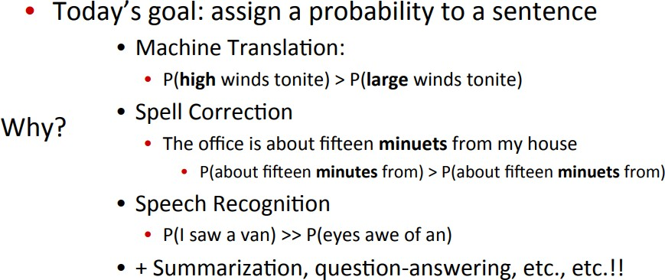
Probabilistic Language Models

Slide 3
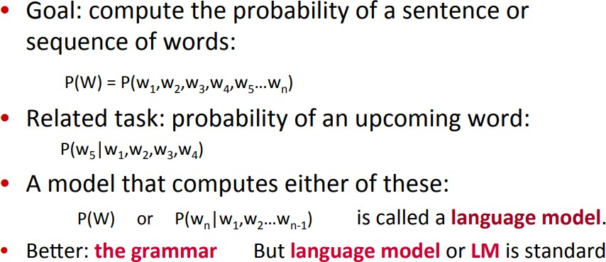
Probabilistic Language Modeling

Slide 4
What is a language model?
Probability distributions over sentences (i.e., word sequences ) : P(W) = P(𝒘_{𝟏}𝒘_{𝟐}𝒘_{𝟑}𝒘_{𝟒} … 𝒘_{𝒌})
Can use them to generate strings
P(𝒘_{𝒌} ∣ 𝒘_{𝟐}𝒘_{𝟑}𝒘_{𝟒} … 𝒘_{𝒌−𝟏})
Rank possible sentences
P(“Today is Thursday”) > P(“Thursday Today is”)
P(“Today is Thursday”) > P(“Today is Sunny”)

Slide 5
Uses of Language Models
Speech recognition
“I ate a cherry” is a more likely sentence than “Eye eight
uh Jerry”
OCR & Handwriting recognition
More probable sentences are more likely correct readings.
Machine translation
More likely sentences are probably better translations.
Generation
More likely sentences are probably better NL generations.
Context sensitive spelling correction
“Their are problems wit this sentence.”

Slide 6
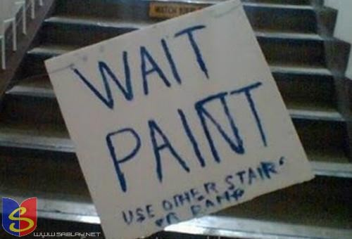
Language model applications
Context-sensitive spelling correction
6

Slide 7
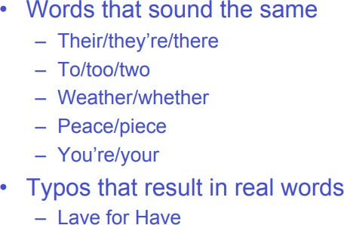
Real Word Spelling Errors

Slide 8


Language model applications
Autocomplete
8

Slide 9
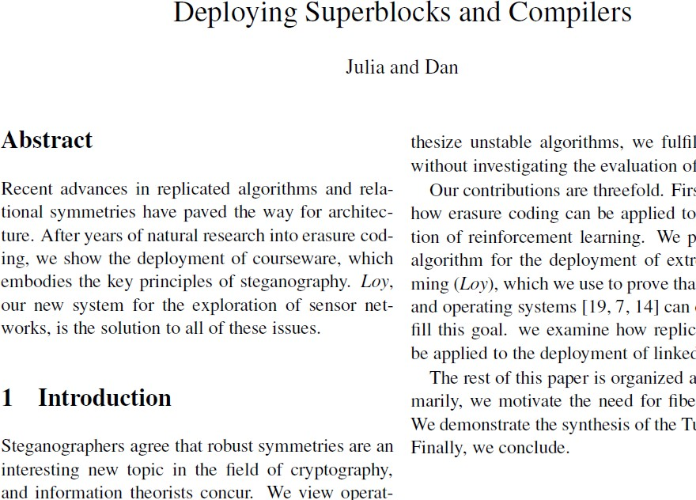
Language model applications
Language generation : https://pdos.csail.mit.edu/archive/scigen/
9

Slide 10
Completion Prediction
A language model also supports predicting the completion of a sentence.
Please turn off your cell
Kindly submit
Predictive text input systems can guess what you are typing and give choices on how to complete it.
10

Slide 11
N-Gram Models of Language
Use the previous N-1 words in a sequence to predict the next word
Language Model (LM)
unigrams, bigrams, trigrams,…
How do we train these models?
Very large corpora

Slide 12
Corpora
Corpora are online collections of text and speech
Brown Corpus
Wall Street Journal
AP newswire
Hansards
Timit
DARPA/NIST text/speech corpora (Call Home, Call Friend, ATIS, Switchboard, Broadcast News, Broadcast Conversation, TDT, Communicator)
TRAINS, Boston Radio News Corpus

Slide 13
Terminology
Sentence: unit of written language
Utterance: unit of spoken language
Word Form: the inflected form as it actually appears in the corpus
Lemma: an abstract form, shared by word forms having the same stem, part of speech, word sense – stands for the class of words with same stem
Types: number of distinct words in a corpus (vocabulary size)
Tokens: total number of words

Slide 14
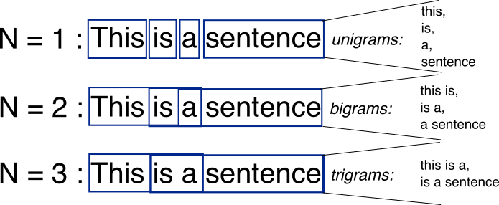
Bag-of-Words with N-grams
N-grams: a contiguous sequence of n tokens from a given piece of text
14

Slide 15
N-Gram Models
Unigram model: 𝑃 𝑤₁ 𝑃 𝑤₂ 𝑃 𝑤₃
… 𝑃(𝑤_{𝑛})
Bigram model: 𝑃 𝑤₁ 𝑃 𝑤₂|𝑤₁ 𝑃 𝑤₃|𝑤₂ … 𝑃(𝑤_{𝑛}|𝑤_{𝑛−1})
Trigram model:
𝑃 𝑤₁ 𝑃 𝑤₂|𝑤₁ 𝑃 𝑤₃|𝑤₂, 𝑤₁ … 𝑃(𝑤_{𝑛}|𝑤_{𝑛−1}𝑤_{𝑛−2})
N-gram model:
𝑃 𝑤₁ 𝑃 𝑤₂|𝑤₁ … 𝑃(𝑤_{𝑛}|𝑤_{𝑛−1}𝑤_{𝑛−2} … 𝑤_{𝑛−𝑁})
15

Slide 16
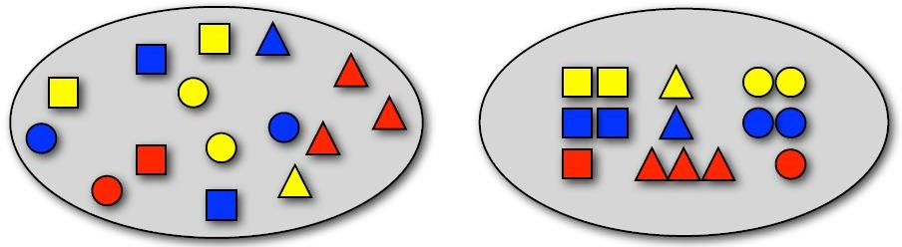




Sampling with replacement
1. P( ) = ? 2. P(□) = ? 3. P(red, □) = ?
4. P(blue) = ? 5. P(red | □) = ?
6. P(□ | red) = ?
8. P(□□🔾) = ?
7. P(
9. P(2 x
) = ?
, 3 x 4 x ) = ?
,
17

Slide 17
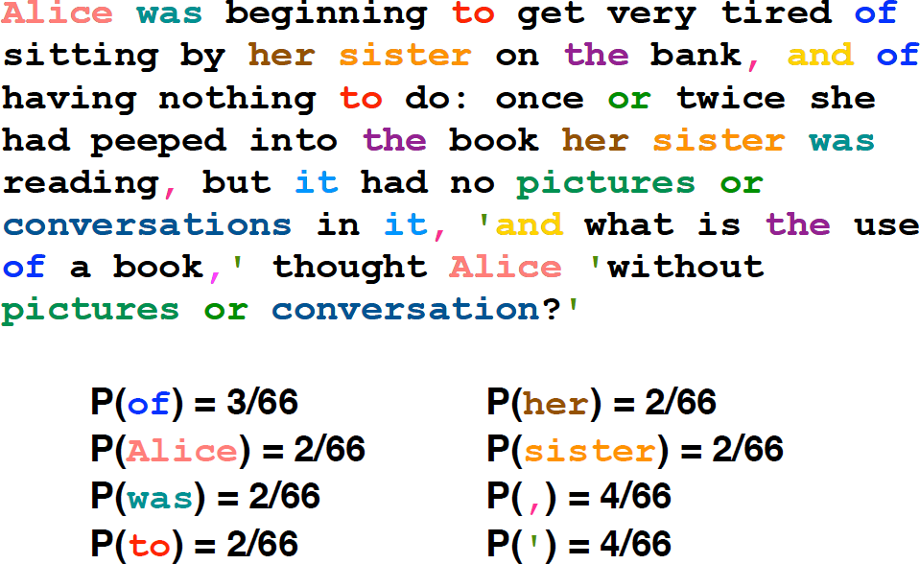
Sampling words with replacement
Example from Julia hockenmaier
18

Slide 18
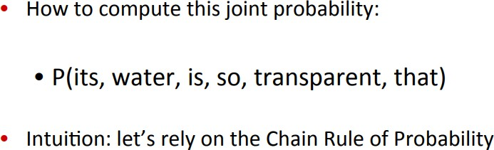
How to compute P(W) ?

Slide 19
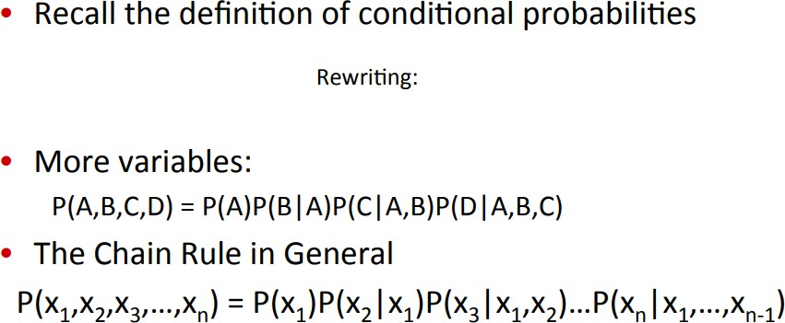
Reminder : Chain Rule

Slide 20
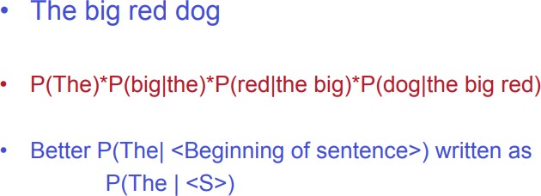
Reminder : Chain Rule

Slide 21
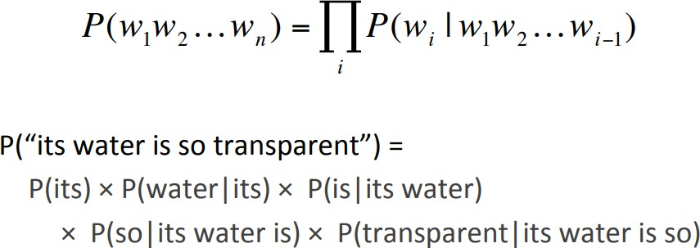
Reminder : Chain Rule
The Chain Rule applied to compute joint probability of words in sentence.

Slide 22
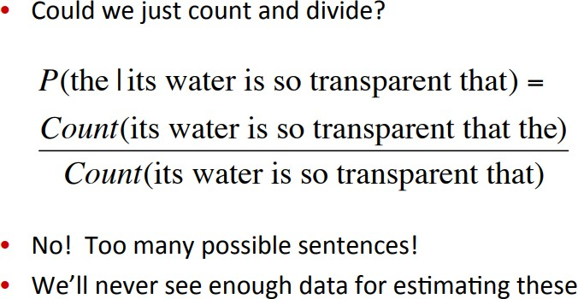
How to estimate these Probabilities ?

Slide 23
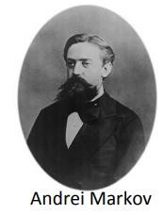
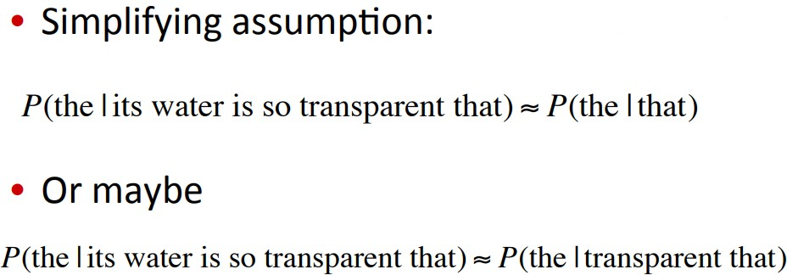
Markov Assumption

Slide 24
Language model with N-gram
The chain rule:
𝐏 𝑿_{𝟏}, 𝑿_{𝟐}, … 𝑿_{𝒏}
𝐏 𝑿_{𝟏} 𝐏 𝑿_{𝟐} 𝑿_{𝟏}
=
𝐏 𝑿_{𝟑} 𝑿_{𝟐}, 𝑿_{𝟏} … 𝑷 𝑿_{𝒏} 𝑿_{𝟏}, … 𝑿_{𝒏−𝟏}
N-gram language model assumes each word depends only on the last n-1 words (Markov assumption)
25

Slide 25
Language model with N-gram
Example: trigram (3-gram)
𝑃 𝑤_{𝑛} 𝑤₁, … 𝑤_{𝑛−1} = 𝑃 𝑤_{𝑛}
𝑃(𝑤₁, … 𝑤_{𝑛})=
^{𝑤}𝑛−2^{, 𝑤}𝑛−1
P 𝑤₁ 𝑃 𝑤₂ 𝑤₁ … 𝑃 𝑤_{𝑛}
^{𝑤}𝑛−2^{, 𝑤}𝑛−1
𝐏 "𝑻𝒐𝒅𝒂𝒚 𝒊𝒔 𝒂 𝒔𝒖𝒏𝒏𝒚 𝒅𝒂𝒚"
=P(“Today”)P(“is”|”Today”)P(“a”|”is”, “Today”)… P(“day”|”sunny”, “a”)
26

Slide 26
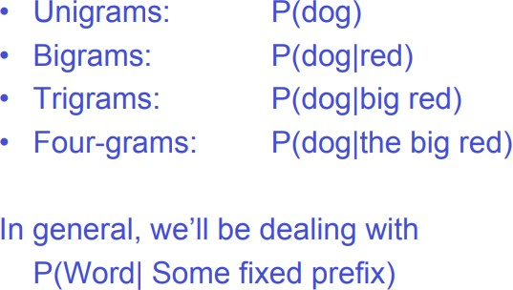
N-grams : Example – The big red dog
27

Slide 27
Language Modeling
Estimating N-gram Probabilities

Slide 28

Maximum Likelihood Estimation or MLE.
An intuitive way to estimate probabilities is called maximum likelihood estimation or MLE.
We get maximum likelihood estimation the MLE estimate for the parameters of an n-gram model by getting counts from a corpus, and normalizing the counts so that they lie between 0 and 1
For example, to compute a particular bigram probability of a word wn given a previous word wn−1, we’ll compute the count of the bigram C(wn−1wn) and normalize by the sum of all the bigrams that share the same first word wn−1:

Slide 29
Estimating bigram probabilities
The Maximum Likelihood Estimate
₎ ₌count(w_{i−1},w_{i} )
P(w | w
i
i−1
count(w )
i−1
₎ ₌c(w_{i−1},w_{i} )
P(w | w
i
i−1
c(w )
i−1

Slide 30
An example
<s> I am Sam </s>
P(w | w
₎ ₌^{c(wi−1,wi )} <s> Sam I am </s>
i
i−1
c(w )
i−1
<s> I do not like green eggs and ham </s>
We estimates the n-gram probability by dividing the observed frequency of a particular sequence by the observed frequency of a prefix.This ratio is called a relative frequency

Slide 31
More examples:
Berkeley Restaurant Project sentences
can you tell me about any good cantonese restaurants close by
mid priced thai food is what i’m looking for tell me about chez panisse
can you give me a listing of the kinds of food that are available
i’m looking for a good place to eat breakfast when is caffe venezia open during the day

Slide 32
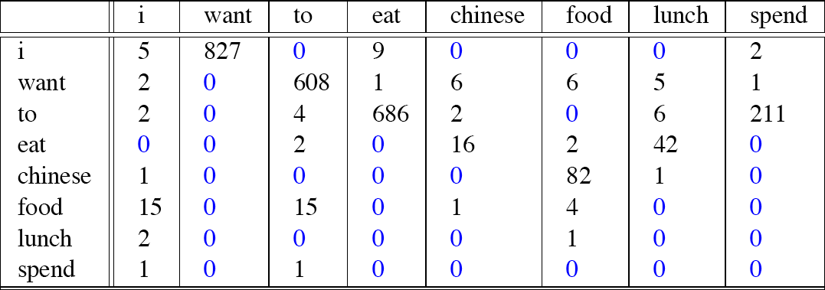
Bigram counts f^{R}or ªeig^{w}ht o^{b}f th^{i}e^{g}w^{r}orªds^{m}(out o^{c}f ºV =^{u}1^{n}446^{t})^{s}in the Berkeley Restaurant Project
corpus of 9332 sentences. Zero counts are in blue

Slide 33
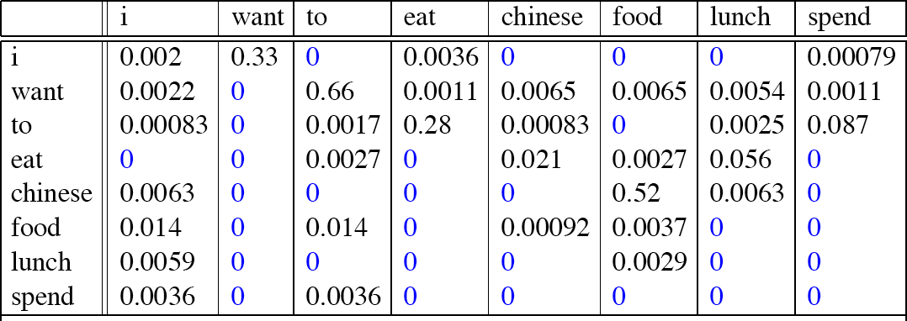
Raw bigram probabilities
Normalize by unigrams:
Result:

Slide 34
Bigram estimates of sentence probabilities
P(<s> I want english food </s>) =
P(I|<s>)
× P(want|I)
× P(english|want)
× P(food|english)
× P(</s>|food)
= .000031

Slide 35
What kinds of knowledge?
P(english|want) = .0011
P(chinese|want) = .0065
P(to|want) = .66 P(eat | to) = .28 P(food | to) = 0 P(want | spend) = 0 P (i | <s>) = .25

Slide 36
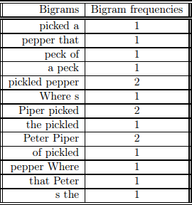


bigrams in our tongue twister
the conditional probability of “Piper” given “Peter”:

Slide 37
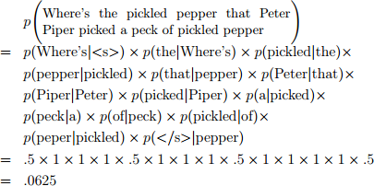

Slide 38
Practical Issues
We do everything in log space
Avoid underflow
(also adding is faster than multiplying)
log(p₁ ×p₂ ×p₃ ×p₄ ) =log p₁ +log p₂ + log p₃ + log p₄

Slide 39
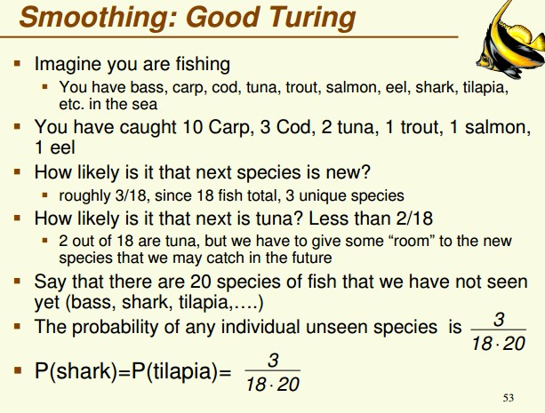

Slide 40
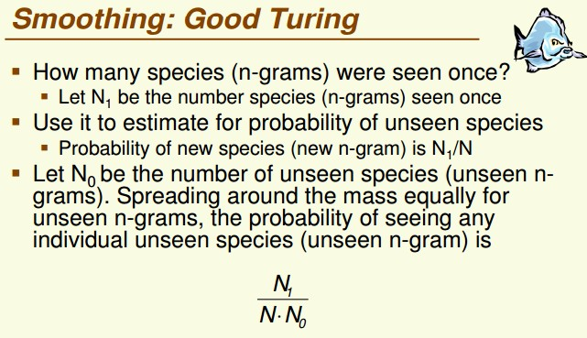

Slide 41
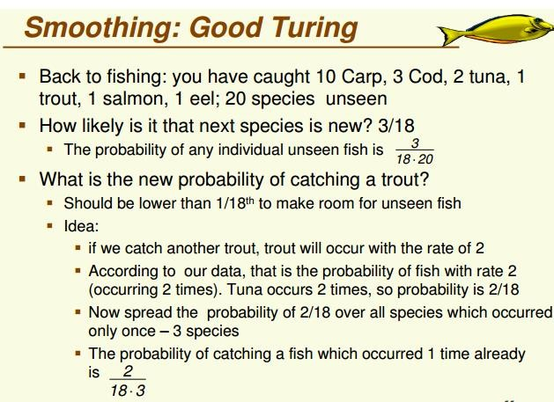

Slide 42
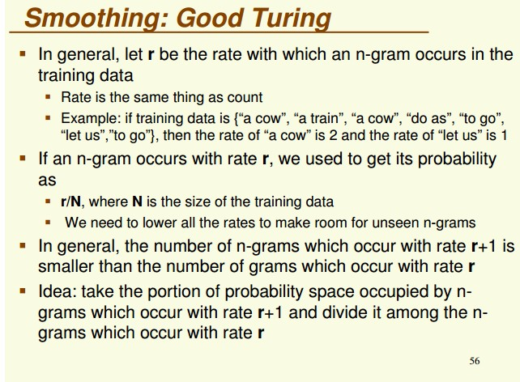

Slide 43
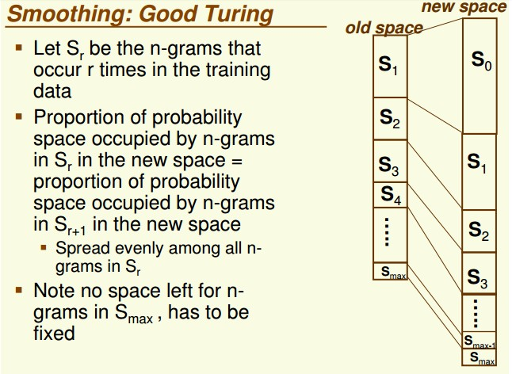

Slide 44
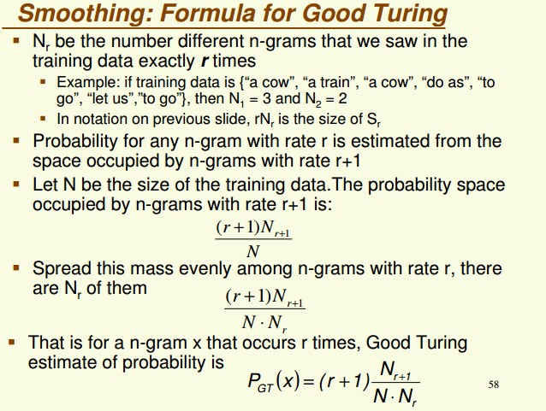

Slide 45
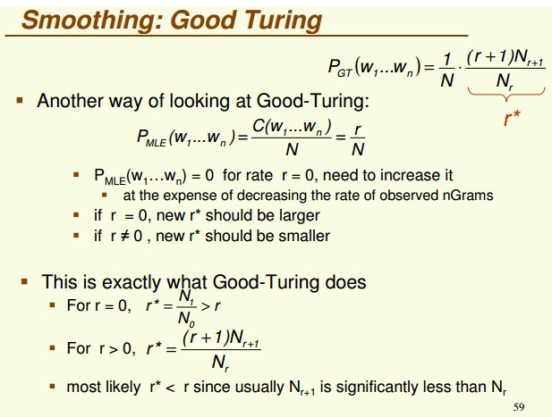

Slide 46
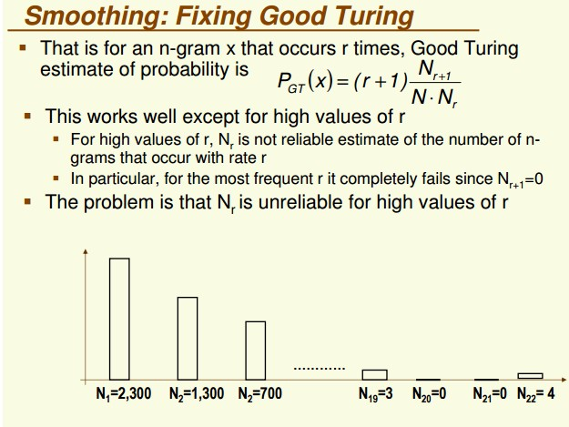
Example : The computer which was kept on the fifth floor got crashed. (predicted)

Slide 47
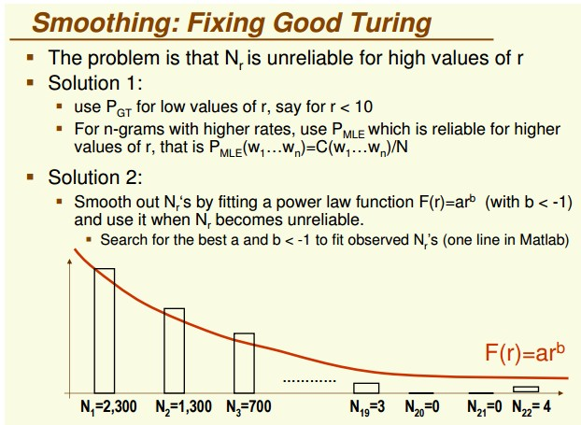

Slide 48
